Slide 1
WADEH: AI-POWERED ARABIC GRAMMAR TOOL
NAME: ABDULLAH AL-SHOBAKI / ABDULRAHMAN AL-AMOUDI DATE: OCTOBER 2024
ENHANCING ARABIC GRAMMAR EDUCATION THROUGH AI

Slide 2
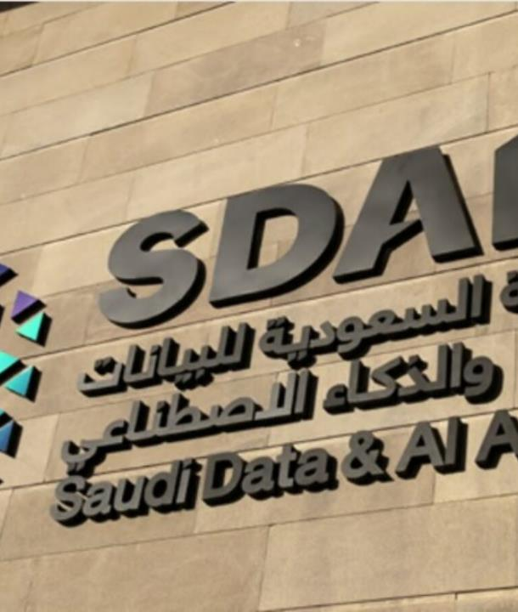
INTRODUCTION TO SDAIA
ESTABLISHMENT AND PURPOSE Founded in 2019, SDAIA leads Saudi Arabia's efforts in AI development, aligning with Vision 2030 to foster a data-driven economy. As a central authority, it sets strategic AI policies and oversees implementation across sectors. GLOBAL LEADERSHIP SDAIA collaborates internationally to position Saudi Arabia as a global AI hub. It engages with top AI firms and global research bodies to ensure advanced AI applications in fields like healthcare, education, and public services.
MAJOR ENTITIES SDAIA operates three main entities: the National Center for AI (NCAI), which drives AI research and deployment; the National Data Management Office (NDMO), focusing on data policies and regulations; and the National Information Center (NIC), responsible for digital infrastructure.

Slide 3
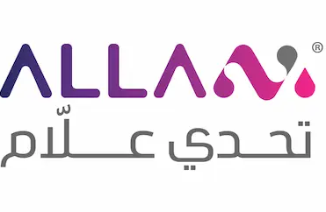

ABOUT ALLAM: SDAIA’S ARABIC LLM
PURPOSE AND DEVELOPMENT
Allam, developed by SDAIA in collaboration with IBM on the Watsonx platform, is an advanced language model specifically designed for Arabic. It empowers the digital future of Arabic by providing advanced natural language processing to understand Arabic grammar, enabling applications like Wadeh.
UNIQUE FEATURES
Understands Arabic grammar and syntax
Supports multiple dialects and contextual language use
ALIGNMENT WITH VISION 2030
As part of Vision 2030’s digital transformation agenda, Allam not only contributes to technological innovation but also aligns with broader national efforts to enhance AI in education, healthcare, and governance.

Slide 4
WHY ALLAM MATTERS
PRESERVATION OF ARABIC
APPLICATIONS ACROSS SECTORS
IMPACT ON ARABIC LANGUAGE
Allam helps preserve and promote Arabic in the digital world by offering high-quality natural language processing (NLP) that caters specifically to Arabic's linguistic nuances.
Allam’s NLP capabilities enhance services in education, government operations, and digital communication. It plays a vital role in improving automated translations, virtual assistants, and learning tools.
By supporting language preservation and enhancing digital communication, Allam contributes to the broader goal of making Arabic one of the most digitally accessible languages, fostering cultural heritage while enabling modern AI solutions.

Slide 5
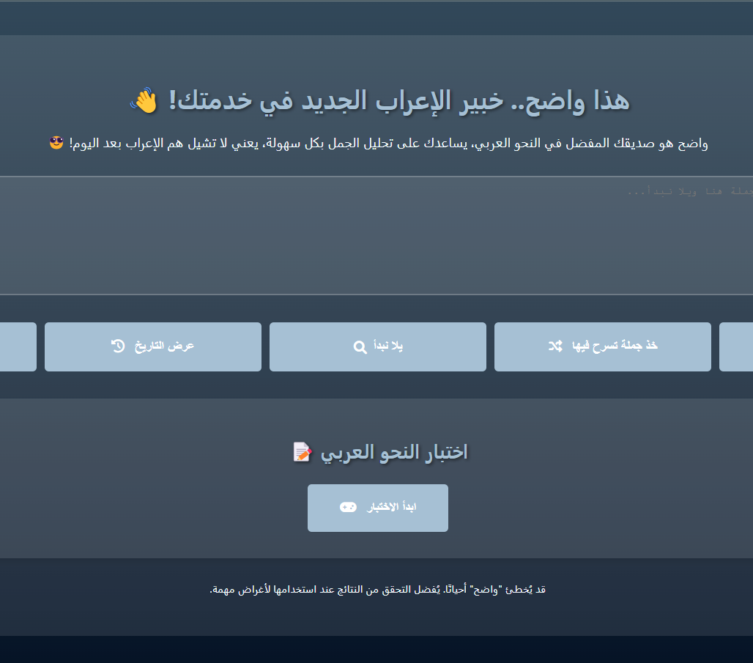
OVERVIEW OF WADEH PROJECT
INTRODUCING WADEH:
WADEH'S PURPOSE
Wadeh is an educational tool that aims to simplify and enhance Arabic grammar learning through AI-driven tools.
CHALLENGE
Arabic grammar complexity poses challenges, especially for non-native speakers. Wadeh aims to bridge this gap through simplified, AI-backed grammar tools.
Goals
Enhance user understanding of grammar with AI-driven analysis, targeting students and Arabic learners.
CORE FEATURES
It offers features that makes it suitable for students, educators, and language enthusiasts such as:
Interactive Quizzes
Voice Input for Sentence Parsing
Instant Feedback on Grammar
TARGET USERS
Wadeh serves Arabic learners of all levels, from students and educators to professional linguists.

Slide 6

HOW WADEH USES ALLAM
INTEGRATION WITH ALLAM
Real-Time Analysis
EDUCATIONAL VALUE
Wadeh utilizes Allam’s advanced NLP capabilities to provide accurate parsing of Arabic grammar. This integration allows WADEH to deliver precise analysis, catering to a variety of Arabic dialects and formal Arabic. Allam’s NLP capabilities enable Wadeh to process complex Arabic grammar, ensuring users have a precise, AI-backed language learning experience.
With real-time grammar correction, Wadeh uses Allam’s power to quickly identify grammatical errors and suggest correct forms, enhancing the learning experience.
Wadeh not only corrects errors but also educates users by providing explanations for grammatical rules, making it an effective learning tool.
USER INPUT
WADEH
FEEDBACK
ALLAM NLP
PROCESSING

Slide 7
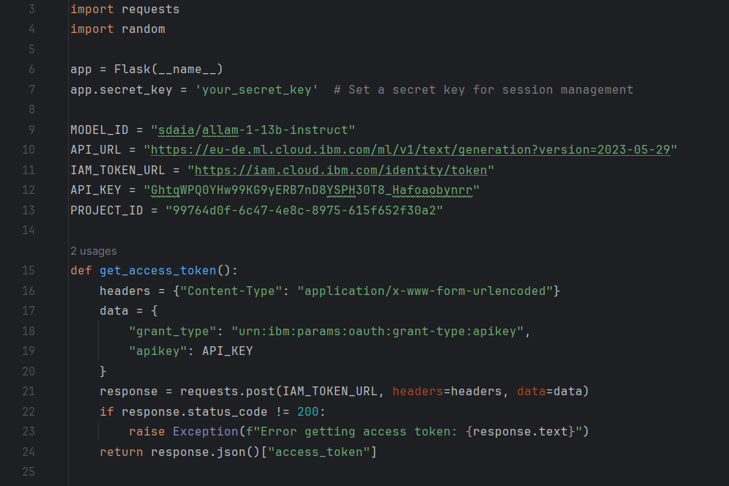
PROJECT DEVELOPMENT PROCESS
STEP 1: RESEARCH AND PLANNING
Wadeh’s development began with extensive research into Arabic grammar and AI applications, aiming to create a tool that is both accurate and user-friendly.
STEP 2: INTEGRATION
Integrating Allam via IBM’s watsonx for robust natural language processing.
STEP 3: TESTING AND FEEDBACK
The tool was tested with a wide range of Arabic texts, from classical literature to modern dialogues. User feedback was crucial, helping refine Wadeh’s features and accuracy.
STEP 4: ITERATIVE IMPROVEMENTS
Based on feedback, Wadeh’s interface and algorithms were improved to ensure optimal user experience and effective grammar learning outcomes.
MILESTONES
Initial development of user interface, integration with IBM Watsonx.
CHALLENGES
Handling complex sentence structures and dialect variations.
NEXT STEPS
User testing to enhance accuracy and additional grammar types.

Slide 8
TECHNICAL DETAILS
TOOLS
PROGRAMMING LANGUAGES
FUTURE GITHUB REPOSITORY
Backend: Python with Flask Framework
Frontend: HTML, CSS, JavaScript
Integration: IBM Watsonx for NLP Processing
Python is used for backend development, with Flask as the framework.
Planning to set up a GitHub repository for team collaboration and version control.

Slide 9
DATA USED FOR TRAINING/EVALUATION
DATA
PREPARATION
FUTURE PLANS
Sample sentences represent different grammatical structures in Arabic, used to refine analysis capabilities. 40+ Arabic sentences used to validate and fine-tune grammar analysis capabilities. No formal datasets are used; sample sentences demonstrate contextual accuracy.
Sentences are tested through Watsonx and categorized to highlight correct and incorrect grammatical forms.
Future plans include expanding the sentence library to include more complex sentence types for improving the accuracy and coverage.

Slide 10
WHAT MAKES WADEH UNIQUE
ADVANCED AI INTEGRATION
INTERACTIVE LEARNING
POTENTIAL APPLICATIONS
Wadeh stands out due to its use of Allam’s state-of-the-art NLP capabilities, offering a unique approach to Arabic grammar learning that is not available in traditional tools.
KEY FINDINGS
Wadeh successfully identifies basic grammar components but faces challenges with colloquial expressions.
Unlike other tools, Wadeh includes interactive quizzes that help users test their knowledge and retain grammar rules effectively.
TRENDS
Users often need help with verb conjugations and sentence agreement, an area we aim to improve.
It has potential uses in education systems, online learning platforms, and corporate language training, making it a versatile tool for Arabic language learning."

Slide 11
FUTURE ENHANCEMENTS
MOBILE APP DEVELOPMENT
REAL-TIME CHAT ASSISTANCE
EXPANDING TO DIALECTS
Plans include developing a mobile version of Wadeh, allowing users to access grammar learning on the go, making it more convenient and user-friendly.
IMMEDIATE FOCUS
Refine sentence analysis, expand sentence types, and improve UI for a smoother user experience.
The next phase will introduce chat-based grammar support, transforming Wadeh into a virtual grammar tutor that provides instant corrections and feedback.
LONG-TERM GOALS
Incorporate user feedback, enhance model accuracy, and expand functionality.
Future updates will also focus on including more Arabic dialects, making Wadeh useful for both formal and informal language learning.

Slide 12
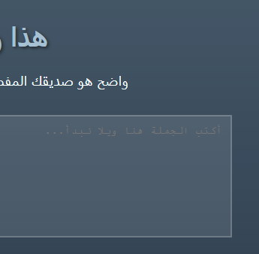
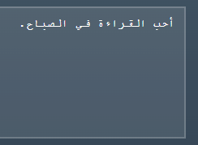
USER GUIDE: STEP-BY-STEP TUTORIAL FOR USING WADEH’S FEATURES
STEP 1: ACCESSING WADEH
Open the Wadeh website in your browser. Ensure that your internet connection is stable.
STEP 2: ENTERING A SENTENCE FOR ANALYSIS
Type or paste an Arabic sentence or use voice input to start the analysis.
STEP 3: VIEWING THE I'RAB ANALYSIS
Wadeh will display the i'rab analysis with color-coded grammar components.

Slide 13
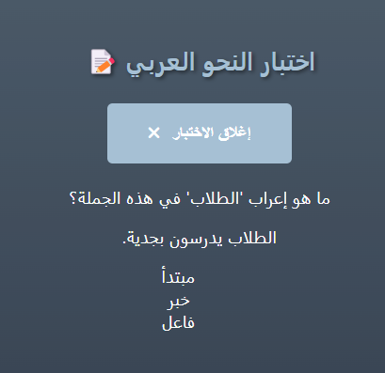
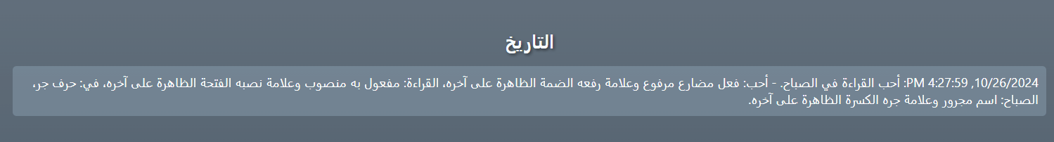
USER GUIDE: INTERACTIVE QUIZZES, HISTORY, AND ADVANCED FEATURES
STEP 4: USING INTERACTIVE QUIZZES:
Click 'Quiz Mode' to test your grammar understanding with immediate feedback.
STEP 5: CHECKING RECENT ANALYSES
Visit the 'History' tab to review past analyses and learn from corrections.

Slide 14
CONCLUSION
WADEH’S GOAL
Wadeh is dedicated to making Arabic grammar learning accessible, engaging, and effective through AI.
MILESTONES
Completed backend development with Flask, integrated IBM Watsonx API for sentence analysis, and gathered initial user feedback.
CHALLENGES
Handling diverse Arabic sentence structures and ensuring accurate grammar analysis.
IMPACT ON ARABIC LANGUAGE LEARNING
Wadeh aligns with Saudi Arabia’s AI goals, contributing to the digital transformation of Arabic language education and cultural preservation.
INVITATION FOR COLLABORATION
We encourage educators, researchers, and AI developers to collaborate with Wadeh’s team to enhance its features and broaden its reach, ensuring Arabic remains a digitally supported language.
LOOKING AHEAD
With ongoing updates and improvements, WADEH aims to become a leading AI tool for Arabic grammar learning, accessible to users worldwide.

